Slide 1

Advanced Java Workshop
Presenter:
Charles Cao, Founder of Service ECVictor Inc.
Master of ECE 2010
Sr. Software Development Engineer in Expedia
10+ Software development experience

Slide 2
Course Outline
Fundamental Programming
The main()
method Primitive Data
Types Variables
Constants
Assignments
Initializations
Operators Strings
Control Flow
Code Examples
& Exercises Classes & Objects

Slide 3
The Java Main Method
In Java, you need to have a method named main in at least one class. The following is what must appear in a real Java program.
public class MainExample {
public static void main(String[] args) {
String helloWorld = "Hello World!";
System.out.println(helloWorld);
}
}

Slide 4
Primitive Data Types
byte: The byte data type is an 8-bit signed two's complement integer.
short: The short data type is a 16-bit signed two's complement integer.
int: By default, the int data type is a 32-bit signed two's complement integer,
long: The long data type is a 64-bit two's complement integer.

Slide 5
float: The float data type is a single-precision 32-bit IEEE 754 floating point.
double: The double data type is a double-precision 64-bit IEEE 754 floating point.
boolean: The boolean data type has only two possible values
char: The char data type is a single 16-bit Unicode character.

Slide 6
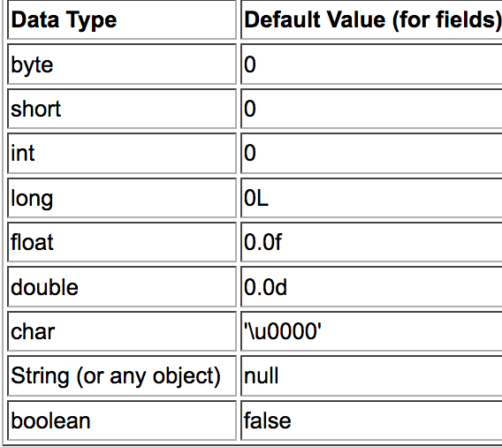
Default Values

Slide 7
Variables
As you learned in the previous lesson, an object stores its state in fields.
int cadence = 0;
int speed = 0;
int gear = 1;
Variable names are case-sensitive.
Subsequent characters may be letters, digits, dollar signs, or underscore characters.
If the name you choose consists of only one word, spell that word in all lowercase letters.

Slide 8
Constants
Java does not directly support constants. However, a static final variable is effectively a constant.
The static modifier causes the variable to be available without loading an instance of the class where it is defined. The final modifier causes the variable to be unchangeable.
e.g.
public static final int MAX_UNITS = 25;

Slide 9
Assignment, Arithmetic, and Unary Operators
The Simple Assignment Operator
int cadence = 0; int speed = 0; int gear = 1;

Slide 10
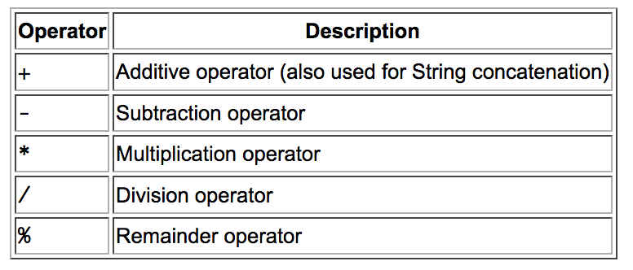
Assignments
The Arithmetic Operators

Slide 11
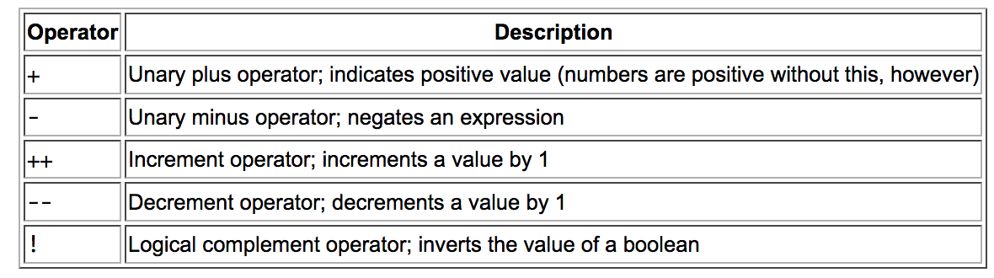
The Unary Operators

Slide 12
Initializations
Initializing classes
class SomeClass {
static boolean b;
static byte by;
static char c;
static double d
}

Slide 13
Introducing class initialization blocks
A class initialization block is a block of statements preceded by the static keyword that's introduced into the class's body. When the class loads, these statements are executed

Slide 14
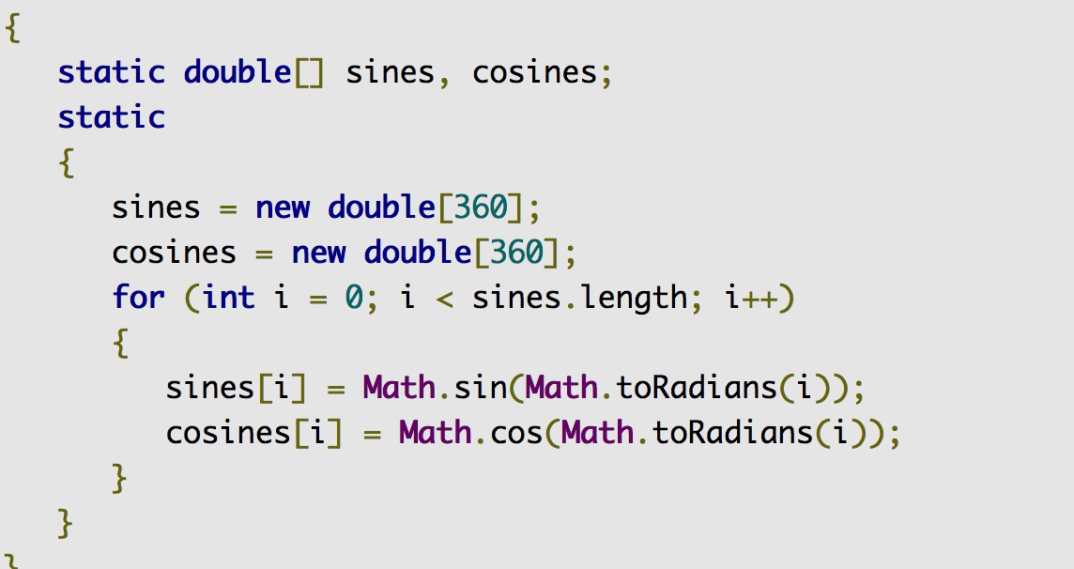
Introducing class initialization blocks

Slide 15
Strings
Creating
The most direct way to create a string is to write:
String greeting = "Hello world!";
As with any other object, you can create String objects by using the new keyword and a constructor. The String class has thirteen constructors that allow you to provide the initial value of the string using different sources, such as an array of characters:
char[] helloArray = { 'h', 'e', 'l', 'l', 'o', '.' };
String helloString = new String(helloArray); System.out.println(helloString);

Slide 16
String Length
String palindrome = "Dot saw I was Tod";
int len = palindrome.length();
Concatenating Strings
string1.concat(string2);
"Hello," + " world" + "!”
Such a concatenation can be a mixture of any objects. For each object that is not a String, its toString() method is called to convert it to a String.

Slide 17
Control Flow
The if-then Statement
if (isMoving){
// the "then" clause: decrease current speed currentSpeed--;
}
The if-then-else Statement
if (isMoving) {
currentSpeed--; }
else { System.err.println("The bicycle has already stopped!"); }

Slide 18
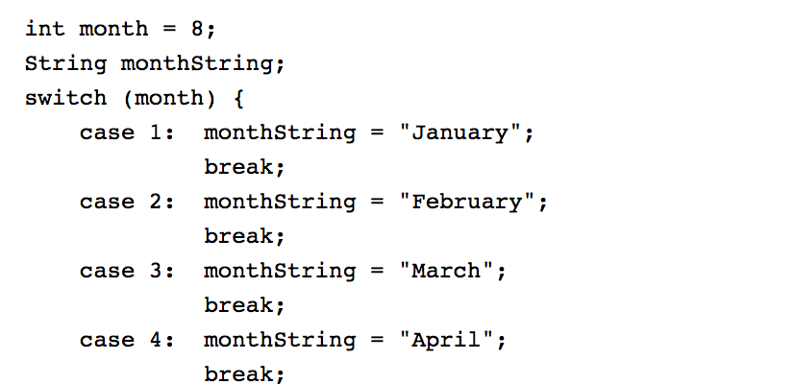
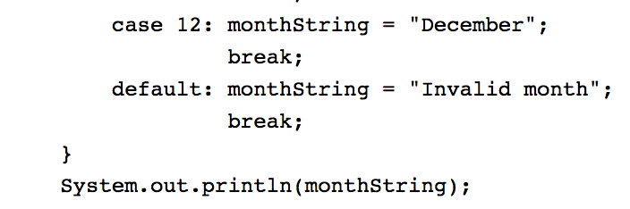
The switch Statement

Slide 19
The while and do-while Statements
while (expression) { statement(s) }
do { statement(s) } while (expression);

Slide 20
The for Statement
for (initialization; termination; increment) { statement(s) }
for(int i=1; i<11; i++){
System.out.println("Count is: " + i);
}

Slide 21
Classes and Objects in Java
Instance Variables
Class Variables
Constructors
Instance Methods
Class Methods
OOP Principles
Instantiation
Encapsulation
Specialization

Slide 22


Classes and Objects in Java
Declaring Classes

Slide 23
Declaring Member Variables
public modifier—the field is accessible from all classes.
private modifier—the field is accessible only within its own class.
In this lesson, be aware that the same naming rules and conventions are used for method and class names, except that
the first letter of a class name should be capitalized, and
the first (or only) word in a method name should be a verb.

Slide 24
Defining Methods
public double calculateAnswer(double wingSpan, int numberOfEngines,
double length, double grossTons) {
//do the calculation here
}
The signature of the method declared above is:
calculateAnswer(double, int, double, double)

Slide 25
Naming a Method
Although a method name can be any legal identifier, code conventions restrict method names. By convention, method names should be a verb in lowercase or a multi-word name that begins with a verb in lowercase, followed by adjectives, nouns, etc. In multi-word names, the first letter of each of the second and following words should be capitalized. Here are some examples:
run runFast getBackground getFinalData

Slide 26
static variable
In Java Variables can be declared with the “static” keyword.
Example: static int y = 0;
When a variable is declared with the keyword static, its called a class variable. All instances share the same copy of the variable. A class variable can be accessed directly with the class, without the need to create a instance.

Slide 27
No “static” Keyword = Instance Variables
Without the static keyword, it’s called instance variable, and each instance of the class has its own copy of the variable.
It is a variable which belongs to the class and not to object(instance)
Static variables are initialized only once , at the start of the execution . These variables will be initialized first, before the initialization of any instance variables
A single copy to be shared by all instances of the class
A static variable can be accessed directly by the class name and doesn’t need any object
Syntax : <class-name>.<variable-name>

Slide 28
Static Methods
t is a method which belongs to the class and not to the object(instance) A static method can access only static data. It can not access non-static data (instance variables) A static method can call only other static methods and can not call a non-static method from it. A static method can be accessed directly by the class name and doesn’t need any object Syntax: <class-name>.<method-name> A static method cannot refer to this or super keywords in anyway

Slide 29
static block
The static block, is a block of statement inside a Java class that will be executed when a class is first loaded into the JVM.

Slide 30
instantiation
In programming, instantiation is the creation of a real instance or particular realization of an abstraction or template such as a class of objects or a computer process.

Slide 31
Instance Methods
a method is not declared static then it's an instance method.
A static method belongs to the class itself and a non-static (i.e instance) method belongs to each object that is generated from that class.

Slide 32
Constructors
A class contains constructors that are invoked to create objects from the class blueprint. Constructor declarations look like method declarations—except that they use the name of the class and have no return type. For example, Bicycle has one constructor:

Slide 33
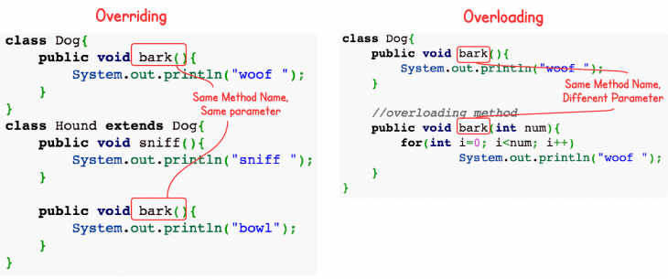
Overloading vs overriding java

Slide 34
Overriding vs. Overloading
The real object type in the run-time, not the reference variable's type, determines which overridden method is used at runtime. In contrast, reference type determines which overloaded method will be used at compile time.
Polymorphism applies to overriding, not to overloading.
Overriding is a run-time concept while overloading is a compile-time concept.

Slide 35
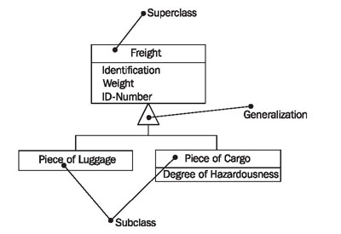
Generalization, Specialization, and Inheritance

Slide 36
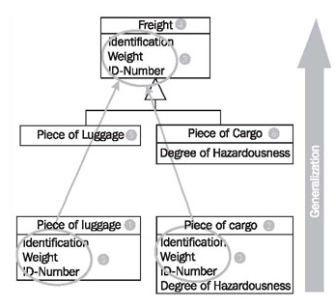
Generalization

Slide 37
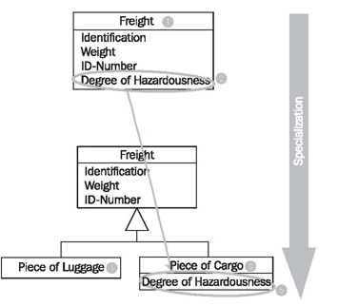
Example of specialization

Slide 38
OOP Principles
Encapsulation
Inheritance
Polymorphism

Slide 39
Encapsulation
Encapsulation means putting together all the variables (instance variables) and the methods into a single unit called Class.
It also means hiding data and methods within an Object. Encapsulation provides the security that keeps data and methods safe from inadvertent changes.

Slide 40
Inheritance
A class that is derived from another class is called a subclass (also a derived class, extended class, or child class). The class from which the subclass is derived is called a superclass (also a base class or a parent class).
Excepting Object, which has no superclass, every class has one and only one direct superclass (single inheritance). In the absence of any other explicit superclass, every class is implicitly a subclass of Object.

Slide 41
Polymorphism
In Core, Java Polymorphism is one of easy concept to understand. Polymorphism definition is that Poly means many and morphos means forms.

Slide 42
What You Can Do in a Subclass
The inherited fields can be used directly, just like any other fields.
You can declare a field in the subclass with the same name as the one in the superclass, thus hiding it (not recommended).
You can declare new fields in the subclass that are not in the superclass.
The inherited methods can be used directly as they are..

Slide 43
You can write a new instance method in the subclass that has the same signature as the one in the superclass, thus overriding it.
You can write a new static method in the subclass that has the same signature as the one in the superclass, thus hiding it.
You can declare new methods in the subclass that are not in the superclass.
You can write a subclass constructor that invokes the constructor of the superclass, either implicitly or by using the keyword super

Slide 44
Nested Classes
The Java programming language allows you to define a class within another class. Such a class is called a nested class and is illustrated here:
class OuterClass { ... class N
estedClass { ... } }

Slide 45
Why Use Nested Classes?
It is a way of logically grouping classes that are only used in one place: If a class is useful to only one other class, then it is logical to embed it in that class and keep the two together. Nesting such "helper classes" makes their package more streamlined.
It increases encapsulation: Consider two top-level classes, A and B, where B needs access to members of A that would otherwise be declared private. By hiding class B within class A, A's members can be declared private and B can access them. In addition, B itself can be hidden from the outside world.

Slide 46
It can lead to more readable and maintainable code: Nesting small classes within top-level classes places the code closer to where it is used.

Slide 47
Private Members in a Superclass
A subclass does not inherit the private members of its parent class. However, if the superclass has public or protected methods for accessing its private fields, these can also be used by the subclass.
A nested class has access to all the private members of its enclosing class—both fields and methods. Therefore, a public or protected nested class inherited by a subclass has indirect access to all of the private members of the superclass.

Slide 48
Questions?
THANK YOU!
MERCI!

